Slide 1
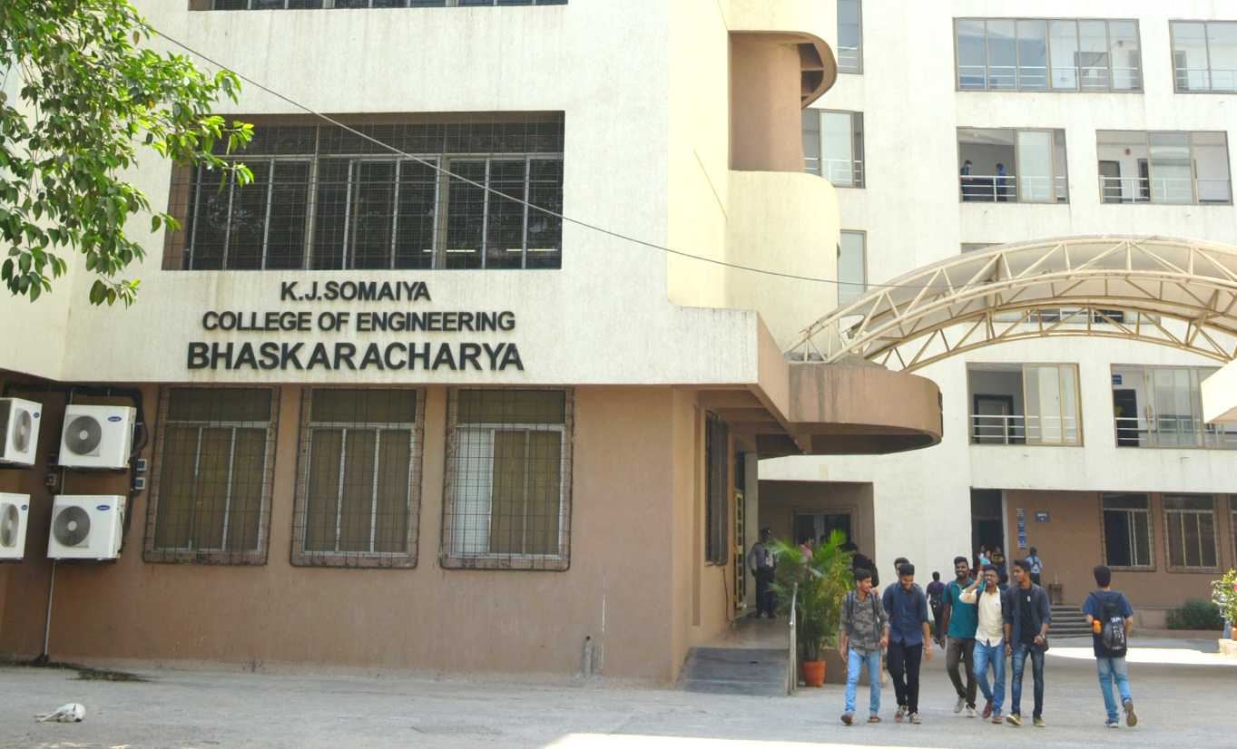
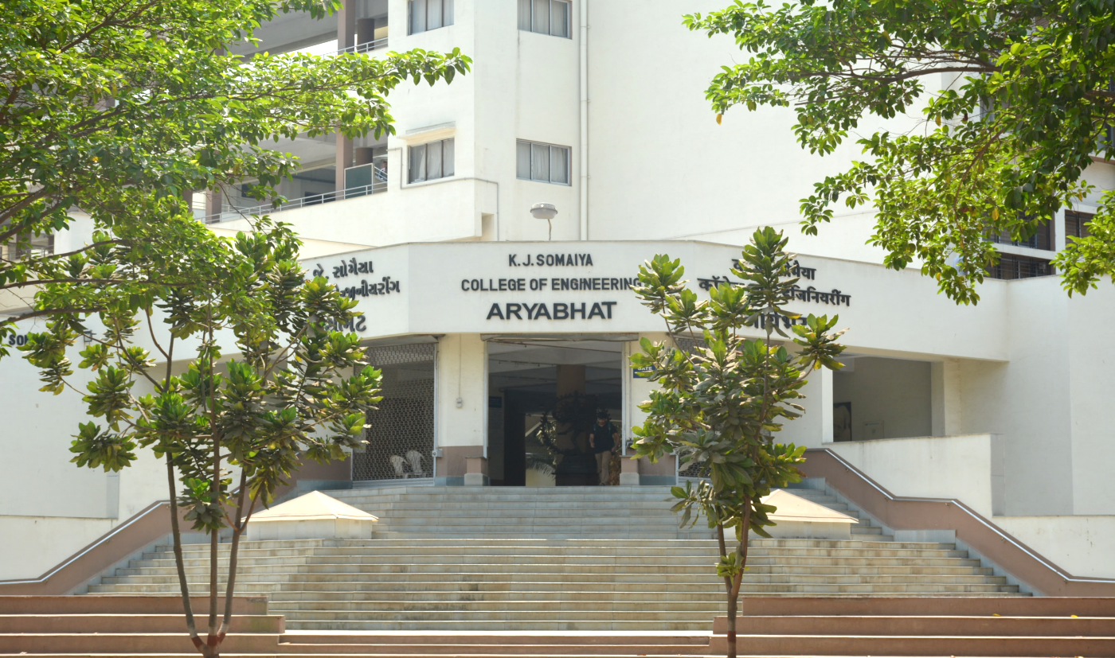
Smart Water Management
Name of Presenter: Group 8
Affiliation: KJ Somaiya college of Engineering

Slide 2
What is Smart Water Management?

Slide 3
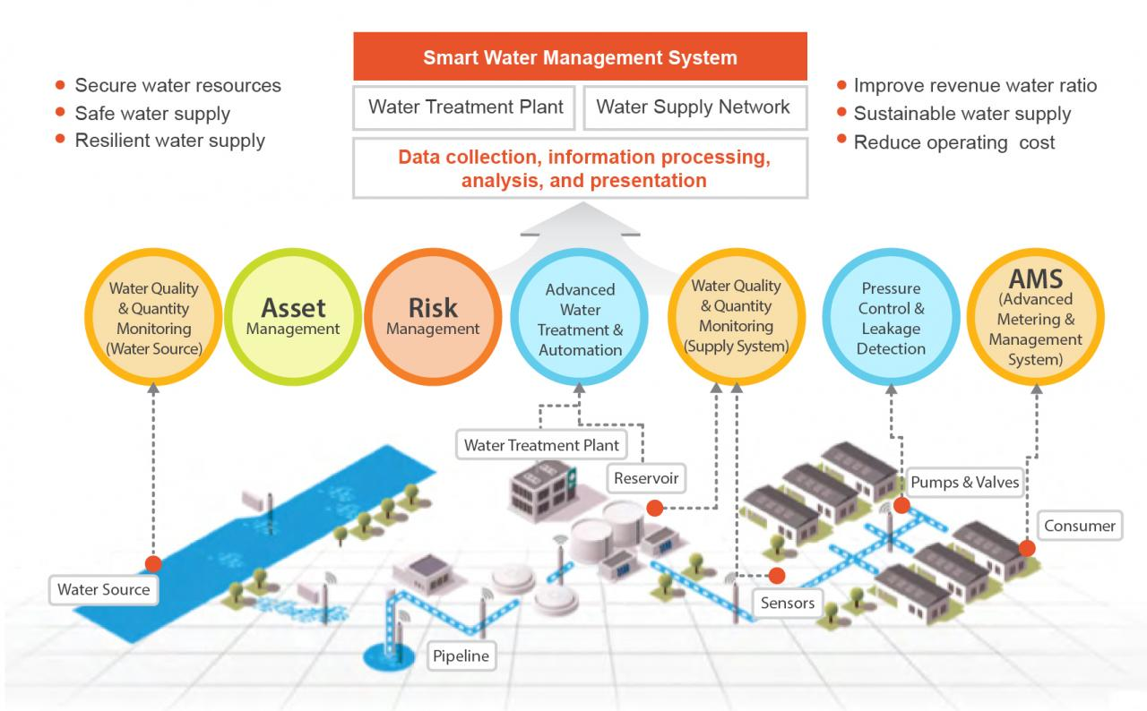

Slide 4
What is AI and What is IoT?

Slide 5
What is IoT ?
IoT stands for "Internet of Things." It refers to the network of physical objects, devices, vehicles, buildings, and other items that are embedded with sensors, software, and connectivity, allowing them to collect and exchange data over the internet.
What is AI?
AI, or Artificial Intelligence, refers to the development of computer systems that can perform tasks that typically require human intelligence. This includes tasks like learning, reasoning, problem-solving, understanding natural language, and even perceiving and interacting with the environment

Slide 6
What is use of AI & IoT in Water Management?
IoT and AI can be used For various functions which may or sometime not maybe humanly possible
Uses of AI
1.Predictive Analytics and Forecasting
2.Smart Irrigation Systems
3.Flood Prediction and Management
4.Groundwater Management
5.Consumer Behavior Analysis
Uses of IoT
1. Smart Sensors and Devices
2. Leak Detection and Management
3. Remote Monitoring of Water Infrastructure
4. Drought Monitoring and Response
5. Compliance and Reporting

Slide 7
Data Management

Slide 8
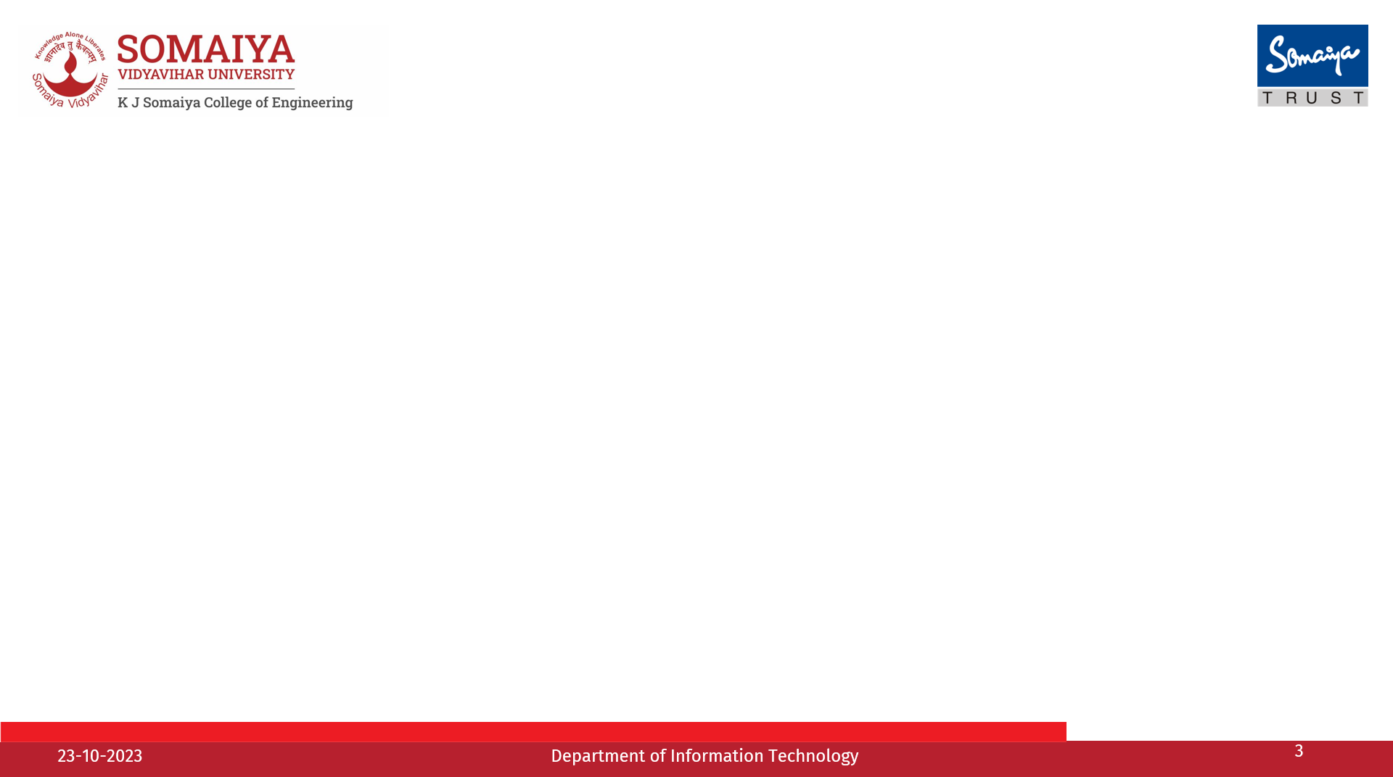
What is Data Management?
It is the process of collecting, organizing and storing data in a way that allows for easy access, retrieval, and use of that data. It involves various activities aimed at ensuring data quality, security, and availability for decision-making and analysis.
Digital technology can improve data collection and analytics to support proactive decisions and increase the efficiency of water utilities.
This data can include information such as water flow rates, water pressure, and water temperature. By analyzing this data, it is possible to identify patterns in water usage and detect anomalies that may indicate inefficient or wasteful use of water.

Slide 9
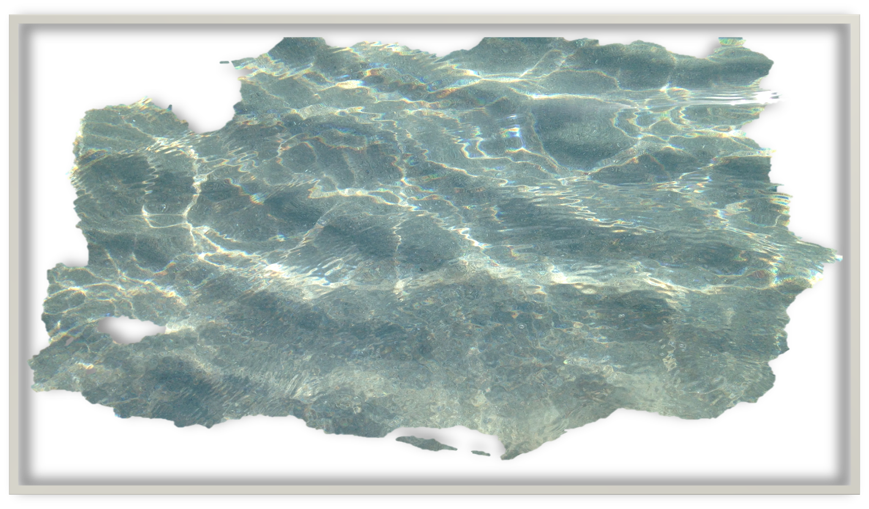
Real-time Monitoring
Historical Analysis and Reporting
Sensor Integration
Integration with IoT and AI
Leak Detection and Prevention
Flood and Disaster Management
How Does Data Management Helps in Smart Water Management ?
Demand Forecasting
Regulatory Compliance
Asset Management
Customer Engagement
Water Quality Management
Resource Allocation

Slide 10

Some common problems faced earlier were:
Identification of the problems accurately wasn’t easy.
This often resulted in data that was incomplete, inaccurate, or out of date.
water conservation strategies relied heavily on manual methods of data collection and analysis.
Lack of technological advancements and resources.

Slide 11

Impact of data analysis, optimum utilisation and role in developing water management solutions:
Real time Data collection and analysis.
Development of strategies and management techniques.
Keeping a track of resources.
Steps to analyze water deprived areas along with areas where water isn’t being conserved.
Use of technology in order to keep the infrastructure upgraded and in proper condition.
Identification of problems beforehand..

Slide 12
Drought Management

Slide 13


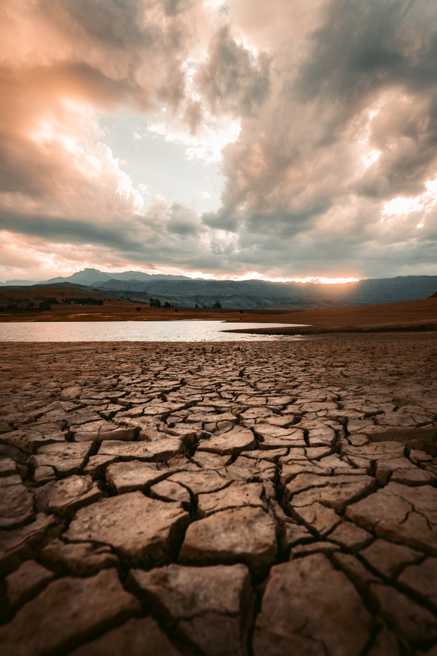
AI Powered Drought Prediction
AI vs. Traditional Methods: AI surpasses traditional drought prediction by analyzing extensive data and uncovering intricate patterns.
Remote Sensing: AI utilizes satellite imagery and remote sensing for real-time monitoring of soil moisture, vegetation health, and water levels.
Scenario Analysis: AI simulates diverse scenarios involving climate change, land use, and water policies to predict potential drought outcomes.
Data-Driven Policy: AI systems provide evidence-based policy recommendations for drought mitigation.
Regression Models: Linear and nonlinear regression models predict drought based on historical data and relevant factors.

Slide 14

Drought Resistant Crops
Enhancing Agricultural Resilience
Beyond Genetic Modification
Beyond Genetic Modification explores innovative agricultural practices, such as precision farming and sustainable crop management, to enhance crop resilience without relying solely on genetic modifications.
Boosting agricultural resilience involves adopting drought-resistant crops and smart irrigation to ensure consistent food production in the face of climate-related challenges.
Millets - The Superfood
Rich in nutrients, they thrive with minimal water requirements. Millets not only nourish but also offer a sustainable solution to drought-related challenges. As water-efficient crops, they empower regions to adapt to water scarcity effectively

Slide 15

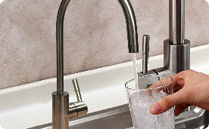

Blockchain Water Trading
Transparent and Efficient
Digital Water Rights
Smart Contracts
Efficient Record Keeping: Digital systems provide a streamlined and accurate way to record water rights, reducing paperwork and human error.
Transformation: Water rights and agreements become smart contracts on the blockchain.
Data Accessibility: Digital systems make data on water rights, transactions, and usage readily accessible to all authorized parties, fostering transparency.
Decentralization: No central authority reduces the risk of manipulation.
Streamlined Transactions: Through smart contracts, water trading becomes swift and automated, reducing bureaucracy and enhancing efficiency.
Transparency & Accountability: Digital records create transparency by making water rights and transactions visible to all stakeholders, promoting fair and accountable water management.
Cost Reduction: By eliminating intermediaries, smart contracts reduce transaction costs, making water trading more cost-effective for all parties involved.

Slide 16

Smart Water Grids in Urban Areas
1
Real-Time Monitoring
Immediate Issue Identification: Real-time monitoring swiftly detects any abnormalities or inefficiencies in water distribution, allowing for immediate issue identification and resolution.
Data-Driven Decision-Making: Continuous monitoring provides data that supports informed decisions to optimize water distribution and resource allocation in real time.
2
Sensors and IoT Devices:
Flow Sensors: Measure water flow rates and detect leaks in the distribution network.
IoT Connectivity: Utilize IoT networks to transmit data from sensors to central control systems.
3
Centralized Control Systems:
SCADA (Supervisory Control and Data Acquisition) Systems: Monitor and control the entire water distribution network from a centralized location.
Automated Valves and Pumps: Use automated valves and pumps that can be controlled remotely based on real-time data and demand.

Slide 17

Drought Management
Explore our webpage dedicated to Drought Management, showcasing the use of AI and IoT technologies for efficient water resource management, all in an engaging and user-friendly design.

Slide 18
Water Quality and Contamination

Slide 19
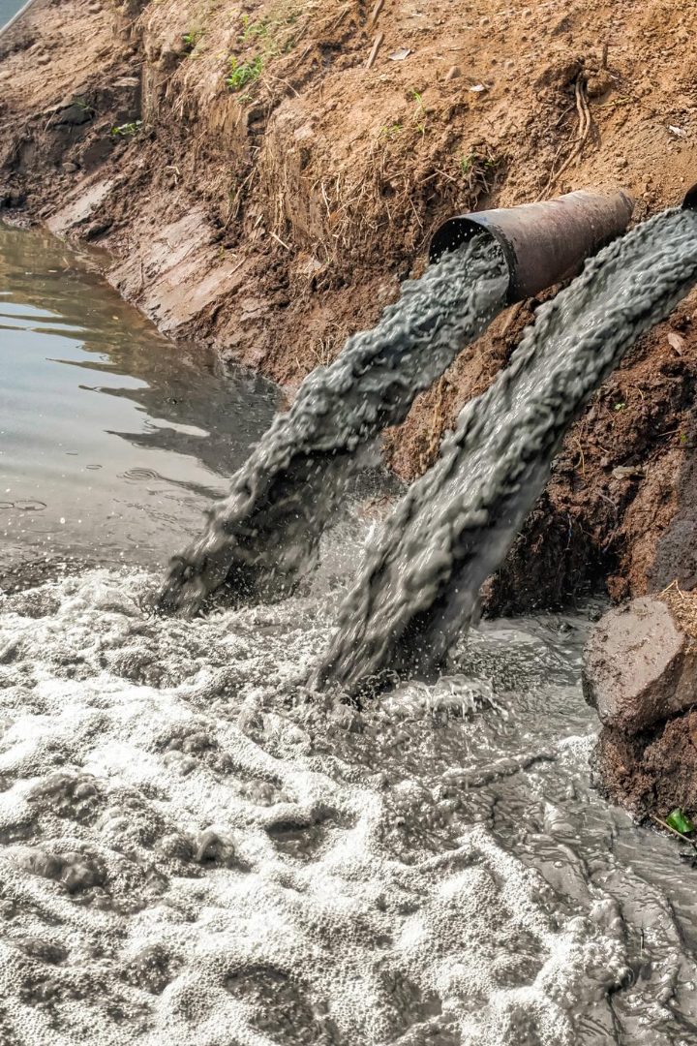

Monitoring and Managing Water Quality Parameters
Water quality refers to the physical, chemical, and biological characteristics of water, which collectively determine its suitability for various purposes, including drinking, industrial use, agricultural use, and sustaining aquatic ecosystems.

Slide 20
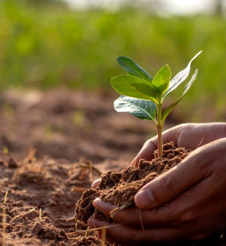
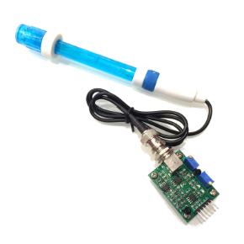
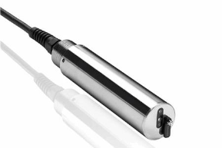
Physical Parameters:
Chemical Parameters:
Biological Parameters:
Temperature:
IoT Solution: Deploy temperature sensors equipped with IoT capabilities to monitor water temperature continuously.
pH:
Pathogens:
IoT Solution: Employ pH sensors connected to IoT networks for continuous pH monitoring.
IoT Solution: Utilize pathogen sensors for real-time monitoring.
Total Suspended Solids (TSS):
Organic Matters and Nutrients:
Chemical Oxygen Demand (COD) and Biological Oxygen Demand (BOD):
IoT Solution: Use TSS sensors equipped with IoT connectivity to monitor suspended particle concentrations.
IoT Solution: Employ sensors to monitor the presence of organic matter and nutrients.
IoT Solution: Use sensors to measure COD and BOD and transmit data through IoT networks.

Slide 21

Smart Water IoT Technology
Water contamination refers to the presence of harmful substances or pollutants in water, making it impure or unfit for its intended use. Contaminants can include various chemical, physical, or biological agents that negatively impact the quality, safety, and suitability of water for human consumption, industrial processes, agriculture, aquatic ecosystems, or recreational activities. Utilizing IoT technology can help detect and mitigate water contamination more effectively. Here are solutions for addressing water contamination using IoT:

Slide 22
Smart Water IoT Technology
1
Early Warning Systems:
Set up IoT systems that provide real-time alerts when contaminants exceed safe levels. These alerts can trigger rapid response actions.
2
Remote Sensing:
Implement remote water quality monitoring using drones or buoys equipped with IoT sensors to assess water quality in remote or hard-to-reach areas.
3
Public Alerts and Notifications:
Use IoT to disseminate water quality alerts and advisories to the public through mobile apps, websites, or SMS messages, ensuring people are informed about potential risks.
4
Leak Detection:
Deploy IoT sensors to identify leaks and pipe breaches, which can introduce contaminants into the water supply. Early detection can prevent widespread contamination.
5
Environmental Sensors:
Integrate environmental sensors with IoT to monitor factors like rainfall, temperature, and runoff, which can influence water contamination risks.

Slide 23
Conclusion
Add something.

Slide 24
Q&A

